Slide 1
Mini Popper | Colt poppers | Pepper poppers | Plates | Wall feet
5 | 4 | 1 | 0 | 47
Bay | Stage | Target Type | Count | NS | Total | Hard Cover
1 | [22-03] Double Stacked | USPSA | 8 | 8 | 16
8 | 06-05 | IPSC | 3 |  | 3
9 | Round Hole, Square Peg | USPSA | 12 | 3 | 15 | 2 Tux 1 Right Diag
10 | Write That Down | USPSA | 9 | 2 | 11 | 1 Tux 1 Left Diag 1 Right Diag
11 | Tight Squeeze | USPSA | 9 | 3 | 12 | 2 Tux
SH | Housing Crisis | IPSC | 11 | 1 | 12 | 2 Tux

Slide 2
Prop | Stage
Swinger | Bay 10 Write that Down
Max trap | Bay 10 write that down
Swinger | Shoot house

Slide 3


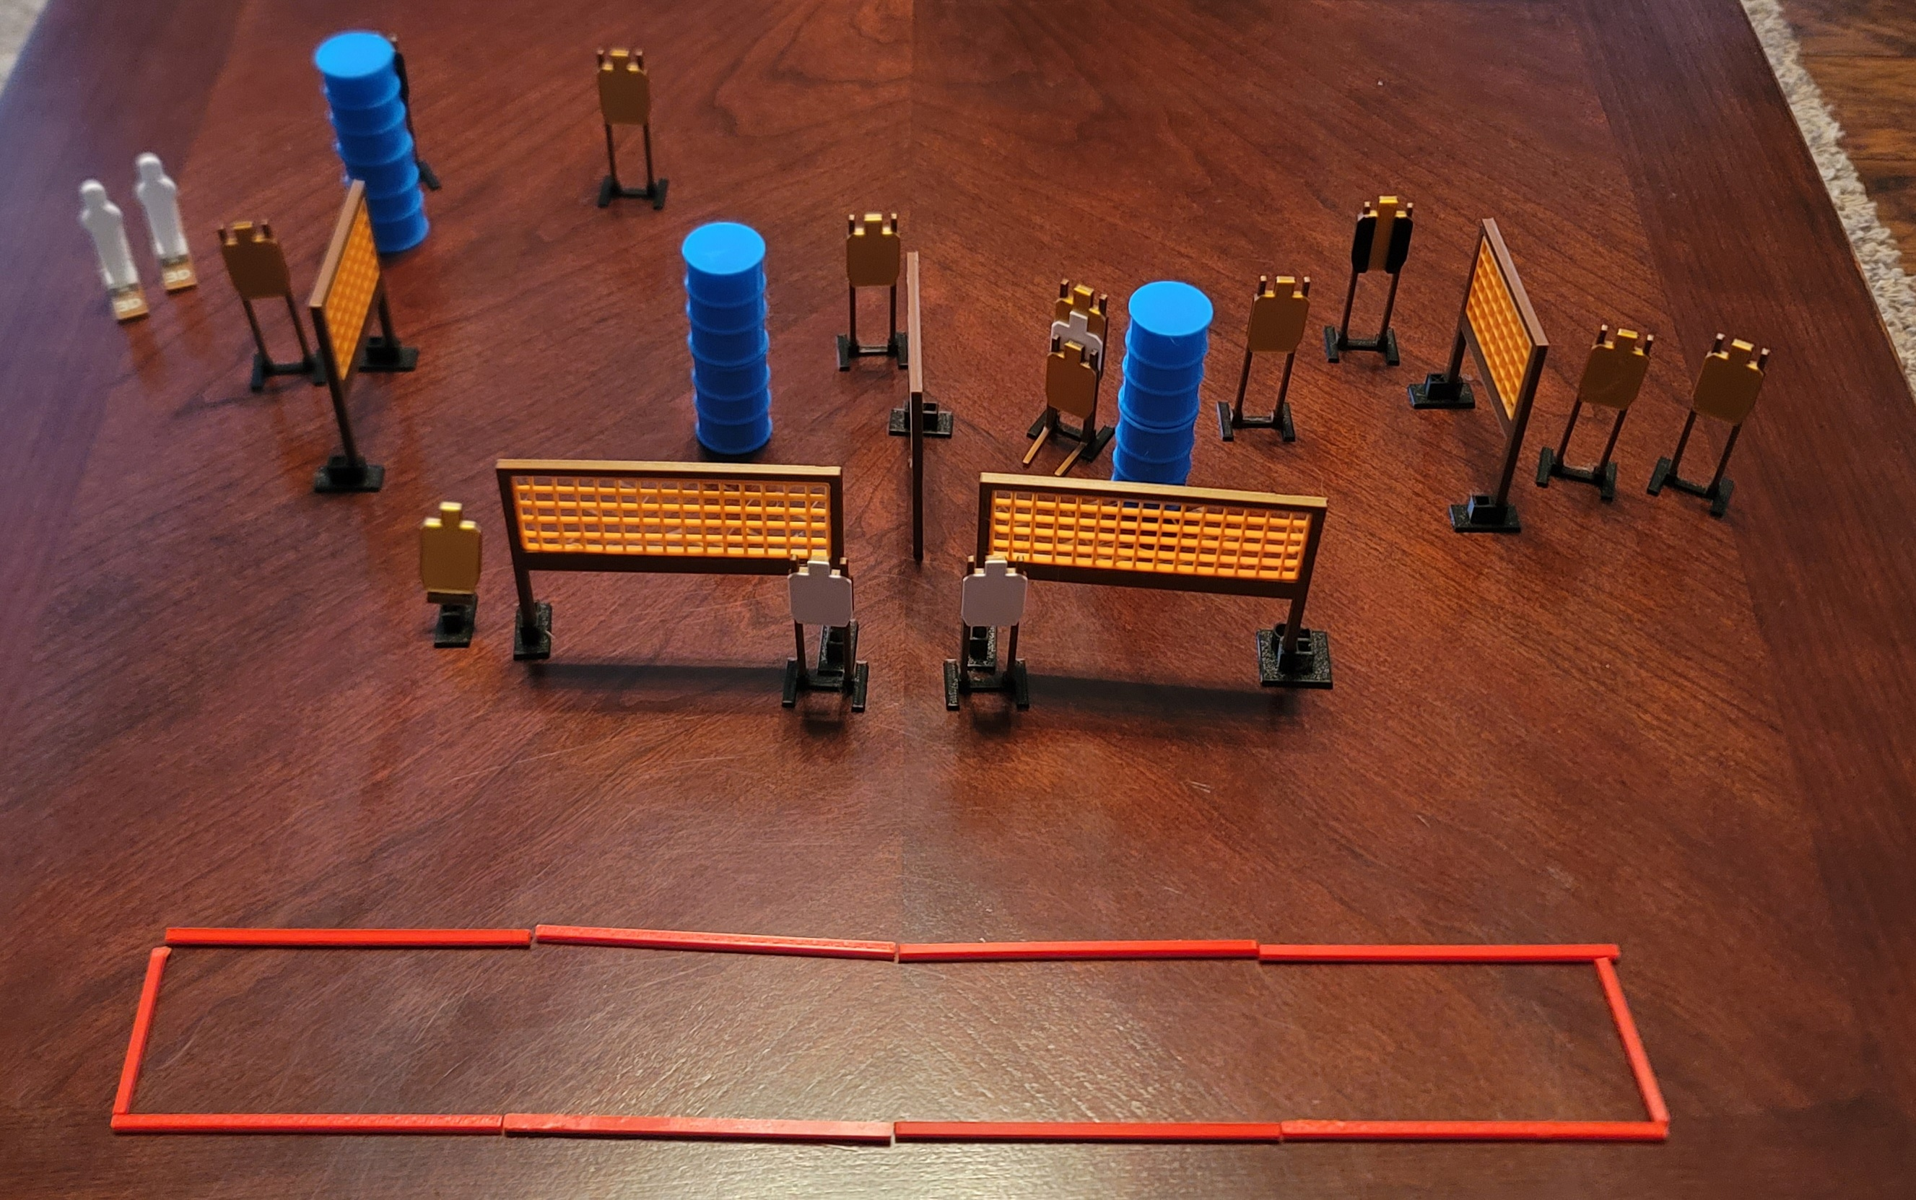
 | Dothan Gun Club – USPSA Match Tight Squeeze Course Designer : Eric Henwood Bay: 11
Round Count 24 rounds 11 USPSA, 2 colt poppers
Equipment List 10 wall feet 2 tux 12 targets (9 + 3 NS)

Slide 4
Tight Squeeze
Written Stage Briefing
Scoring: Comstock Rounds: 24
Targets: 11 USPSA, 2 steel
Handgun start position: anywhere completely outside the shooting area, wrists below belt. Handgun is loaded and holstered.
PCC start position: anywhere completely outside the shooting area, stock on belt. Loaded carbine is held with both hands, safety on.
Stage Procedure: on the audible start signal, engage targets as they become available from within he shooting area.

Slide 5
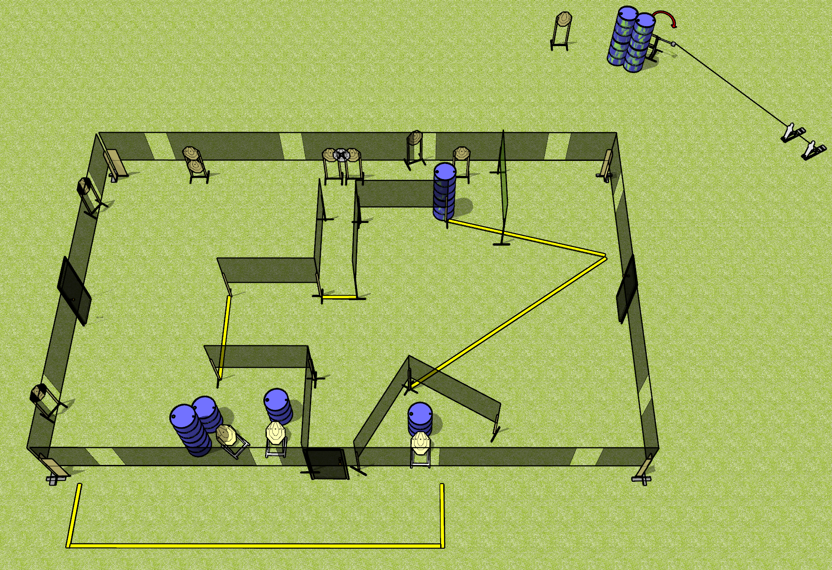
 | Dothan Gun Club – USPSA Match Housing Crisis Course Designer : Drew Coleman Bay: SH
Round Count 28 rounds 13 ISPC 2 mini poppers
Equipment List 2 wall feet Swinger + activator 2 tux 12 targets (11 + 1 NS)

Slide 6
Housing Crisis
Written Stage Briefing
Scoring: Comstock Rounds: 28
Targets: 13 IPSC, 2 steel
Handgun start position: anywhere inside the shooting area, wrists below belt. Handgun is loaded and holstered.
PCC start position: anywhere inside the shooting area, stock on belt. Loaded carbine is held with both hands, safety on.
Stage Procedure: on the audible start signal, engage targets as they become available from within the shooting area. The swinger is activated by either popper and remains visible at rest.

Slide 7
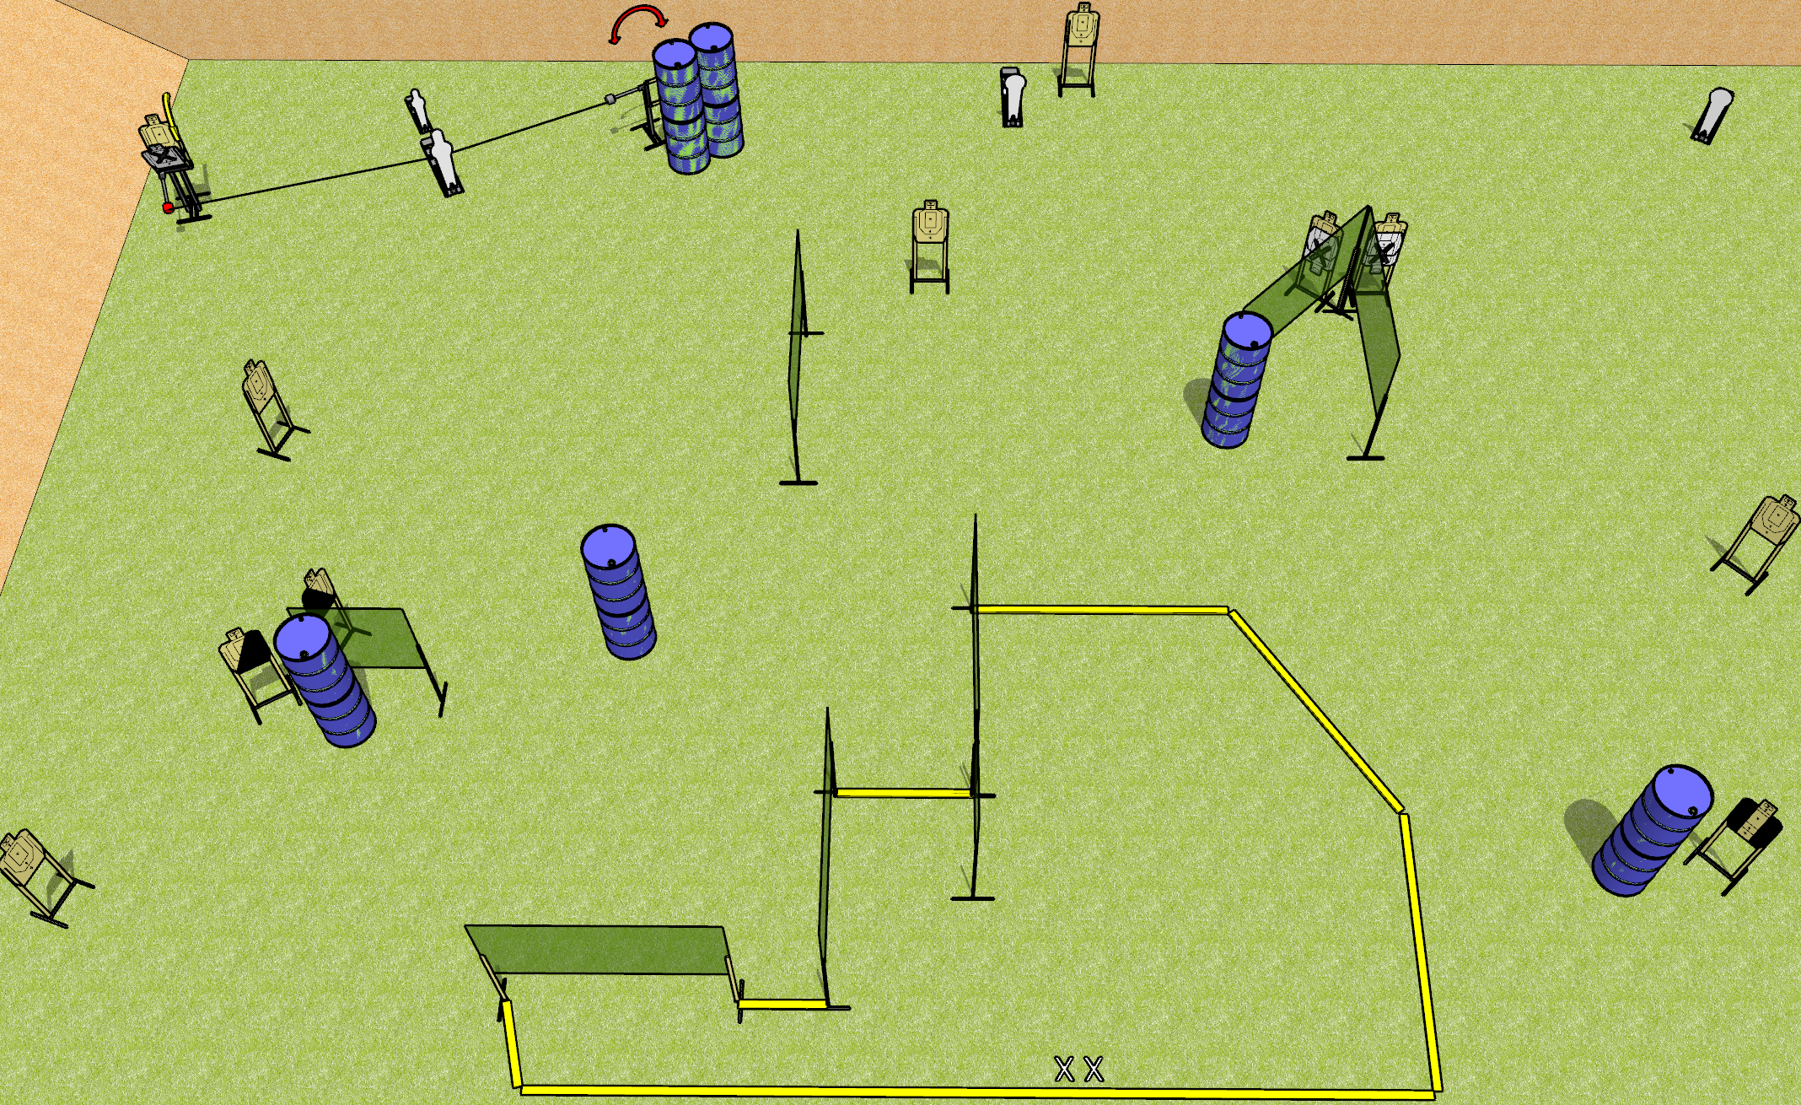
 | Dothan Gun Club – USPSA Match Write That Down Course Designer : Drew Coleman Bay: 10
Round Count 28 rounds 12 USPSA 1 mini, 1 pepper, 2 colts
Equipment List 15 wall feet Swinger, max trap, activators 1 left + 1 right diag, 1 tux 12 targets (9 + 3NS)
10’
10’
5’
4’ wall
10’
3’
3’
30’ back fault line

Slide 8
Write That Down
Written Stage Briefing
Scoring: Comstock Rounds: 28
Targets: 12 USPSA, 4 steel
Handgun start position: feet on X’s, wrists below belt. Handgun is loaded and holstered.
PCC start position: feet on X’s, stock on belt. Loaded carbine is held with both hands, safety on.
Stage Procedure: on the audible start signal, engage targets as they become available from within the shooting area. The max trap and swinger are both activated by the P1 and remain visible at rest.

Slide 9
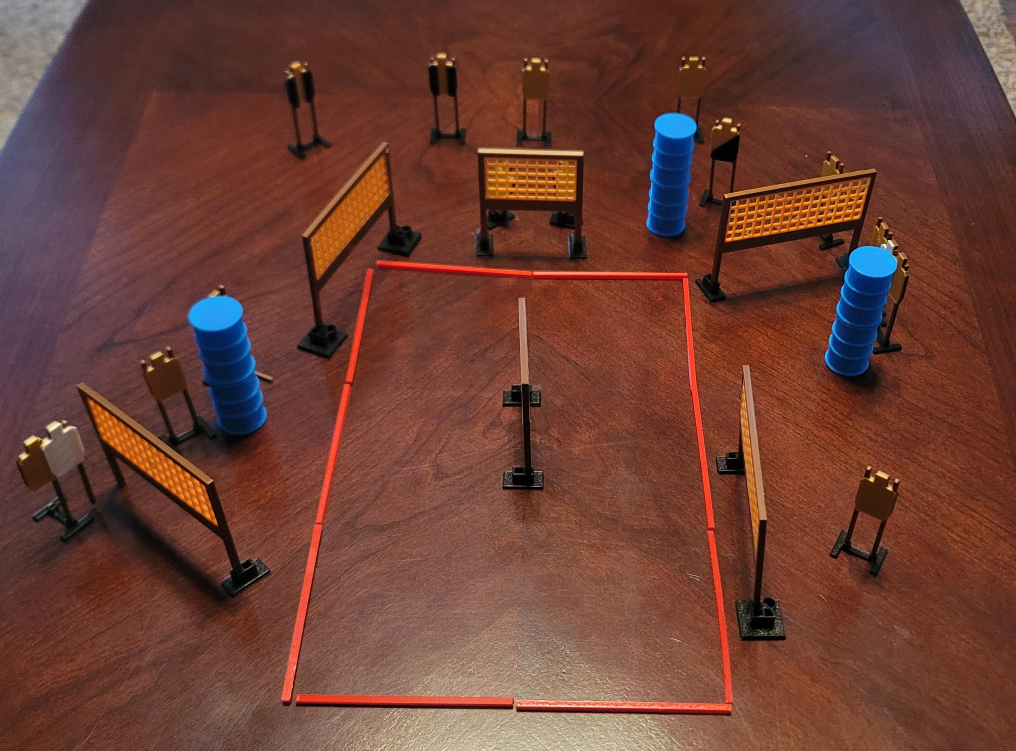
 | Dothan Gun Club – USPSA Match Round Hole, Square Peg Course Designer : Eric Henwood Bay: 9
Round Count 30 rounds 15 USPSA
Equipment List 12 wall feet 2 tux, 1 right diag 15 targets (12 + 3 NS)

Slide 10
Round Hole, Square Peg
Written Stage Briefing
Scoring: Comstock Rounds: 30
Targets: 15 USPSA
Handgun start position: toes on X’s, wrists above shoulders. Handgun is loaded and holstered.
PCC start position: toes on X’s, stock on belt. Loaded carbine is held with both hands, pointed at cone.
Stage Procedure: on the audible start signal, engage targets as they become available from within the shooting area.

